Slide 1
Deaths in the U.S.
Mark Drummond

Slide 2
Forecasting Deaths in the United States
What is the best forecasting model to predict deaths in the U.S.
How has the death rate changed over time
Has COVID-19 impacted the death rates in the United States.

Slide 3
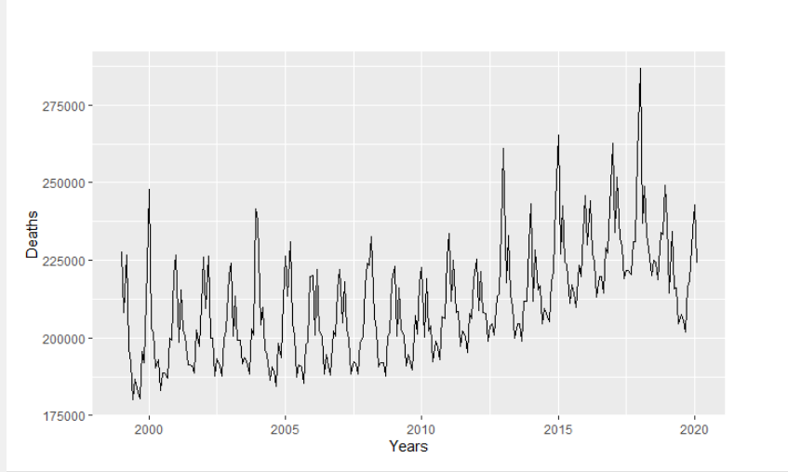
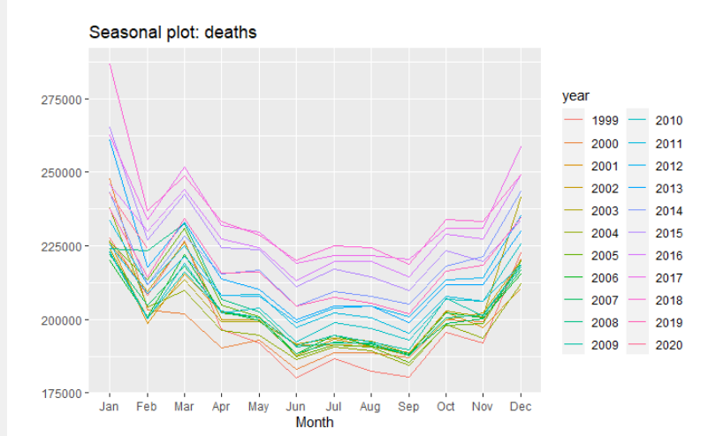
Actual death rates Jan 1999 to Feb 2020
Data published on the Center for Disease Control and Prevention (CDC) website
Total death from Jan 1999 through October 2020.
Deaths from COVID-19 from March 2020 to October 2020
Seasonal with an upward trend
Spike Jan 2018 - 286,744 then a dip June 2019 – 204,516

Slide 4
Forecasting Models Evaluated
Simple moving Averages (SMA) & Exponential smoothing (SES)
Simple Linear Regression (SLR)
Holt, Holt Winters (HW), and Exponential smoothing state space model (ETS)
Arima Models.
Model Group | Best Model in Group | RMSE | Rank Based on RMSE
Arima Models | Manual Arima | 4,787.37 | 1
Holt, HW and ETS | ETS | 5,037.35 | 2
SLR | Trend + season | 7,431.87 | 3
SMA & SES | SES | 13,246.03 | 4

Slide 5
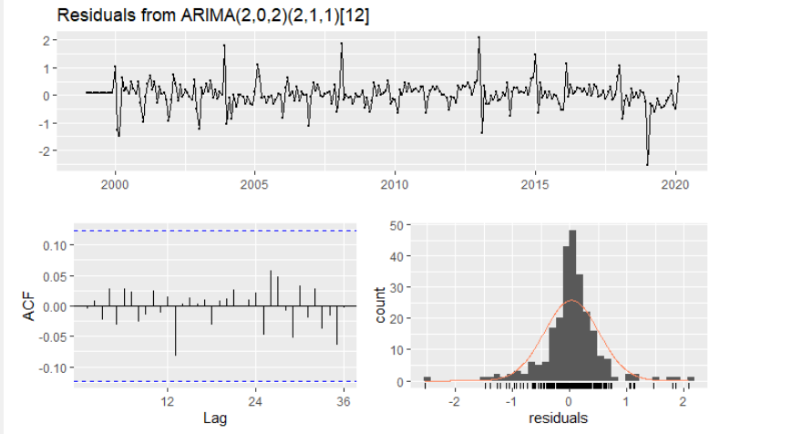
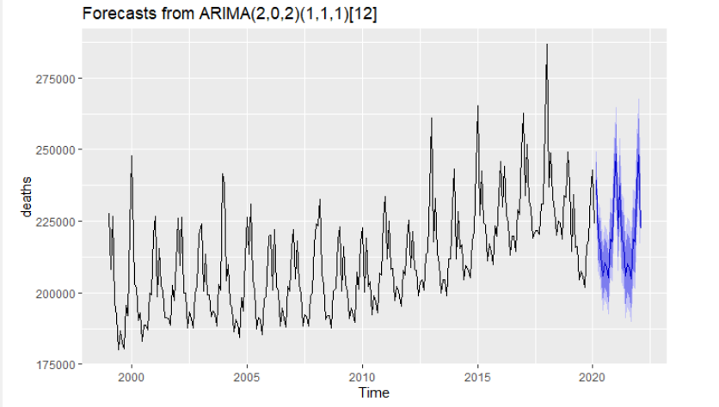
Forecasted death rates using an ARIMA Model
The model used both non-seasonal and seasonal parameters
2 orders of regression in both, 1 diff in seasonal and 2 and 1 moving averages
The residuals look good, ACF all peaks are with in tolerance and they have a normal distribution

Slide 6
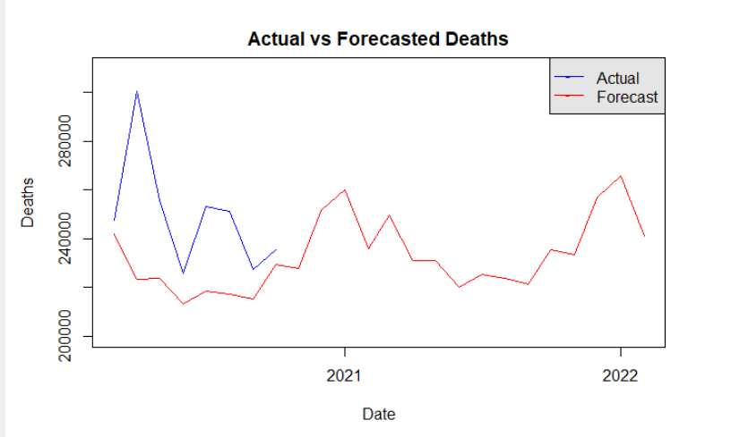
Actual vs Forecasted
Forecasted is off by an average of 10% and a high as 26%
This would indicate other I factor(s) needed to forecast with less error.
Notes:
When I tested actual against Forecast I was off by an average of 10% and a high of 26%
This would tell me that I need some additional factors added to my model to be more precise. Maybe something like hospital admissions

Slide 7
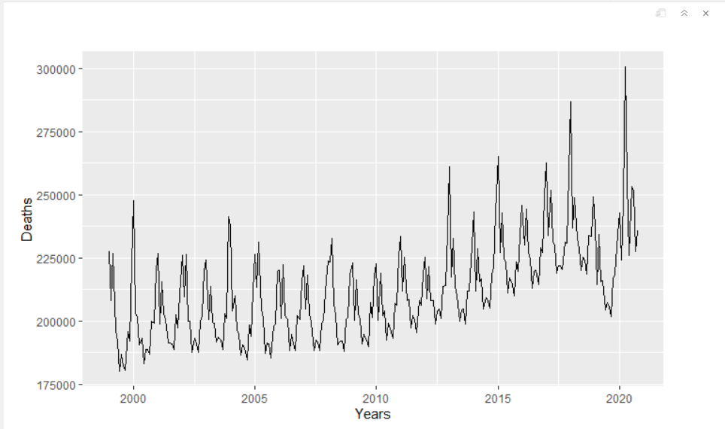
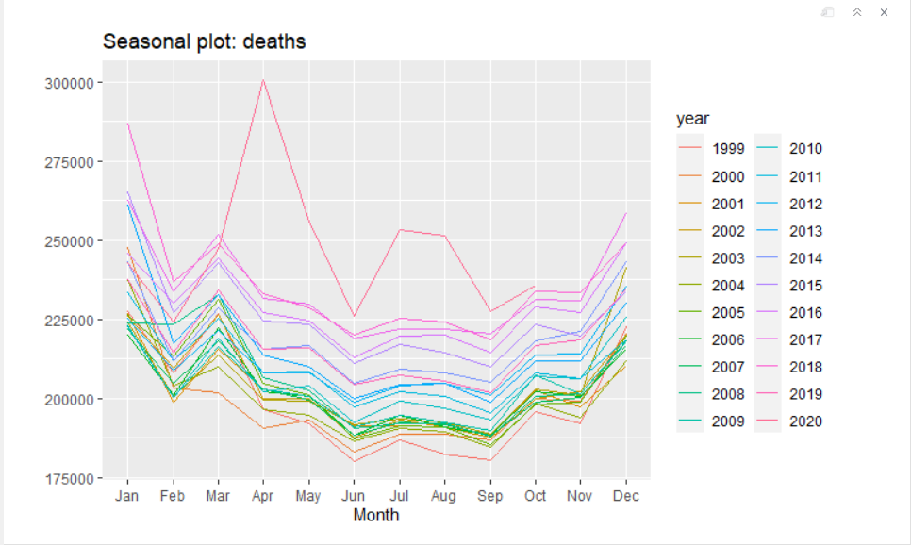
Actual including up to October 2020
The number of deaths reported for COVID-19 is higher than the difference between forecasted and actual.
This would indicate that COVID-19 has a higher impact than the variance.
Notes:
Finally I looked to see if the Deaths from COVID could explain the difference between my forecast and the actual deaths reported
What I found was the deaths reports as COVID-19 was much higher than difference between the two

